Slide 1
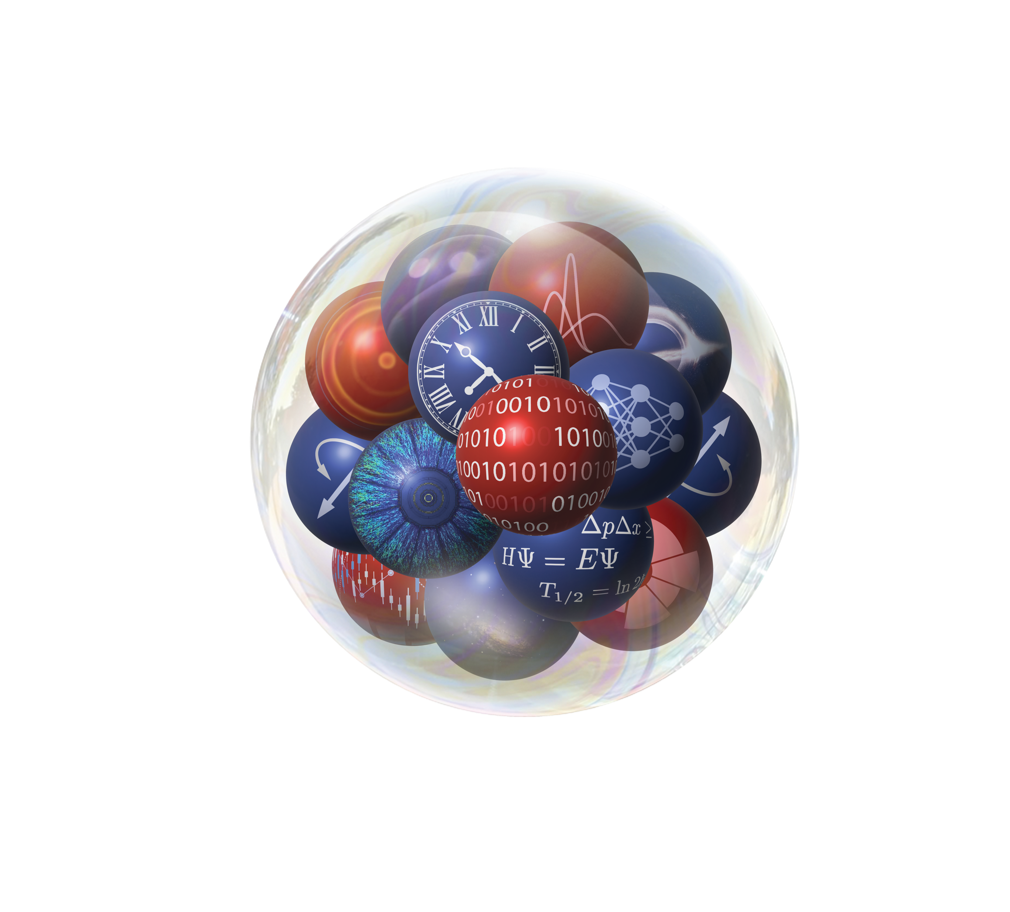
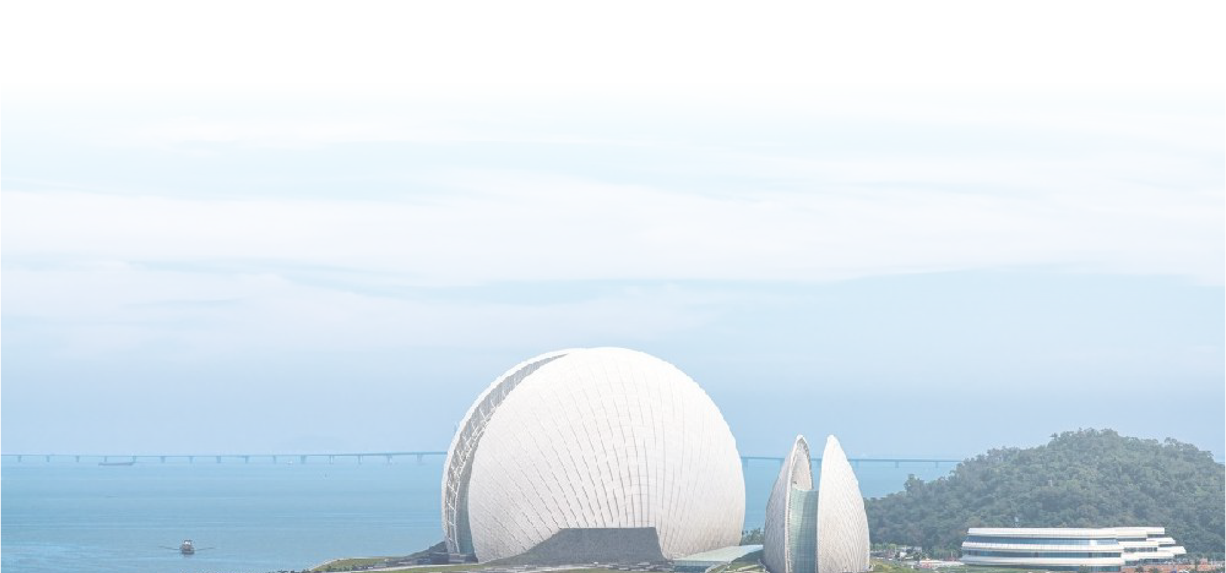
Emulators for Open Quantum Systems
Simin Wang (S. M. Wang)
Fudan University
Collaborators: R. Y. Cheng, Z. C. Xu, K. Godbey, X. L. Zhang,
W. Nazarewicz, Y. G. Ma …

Slide 2
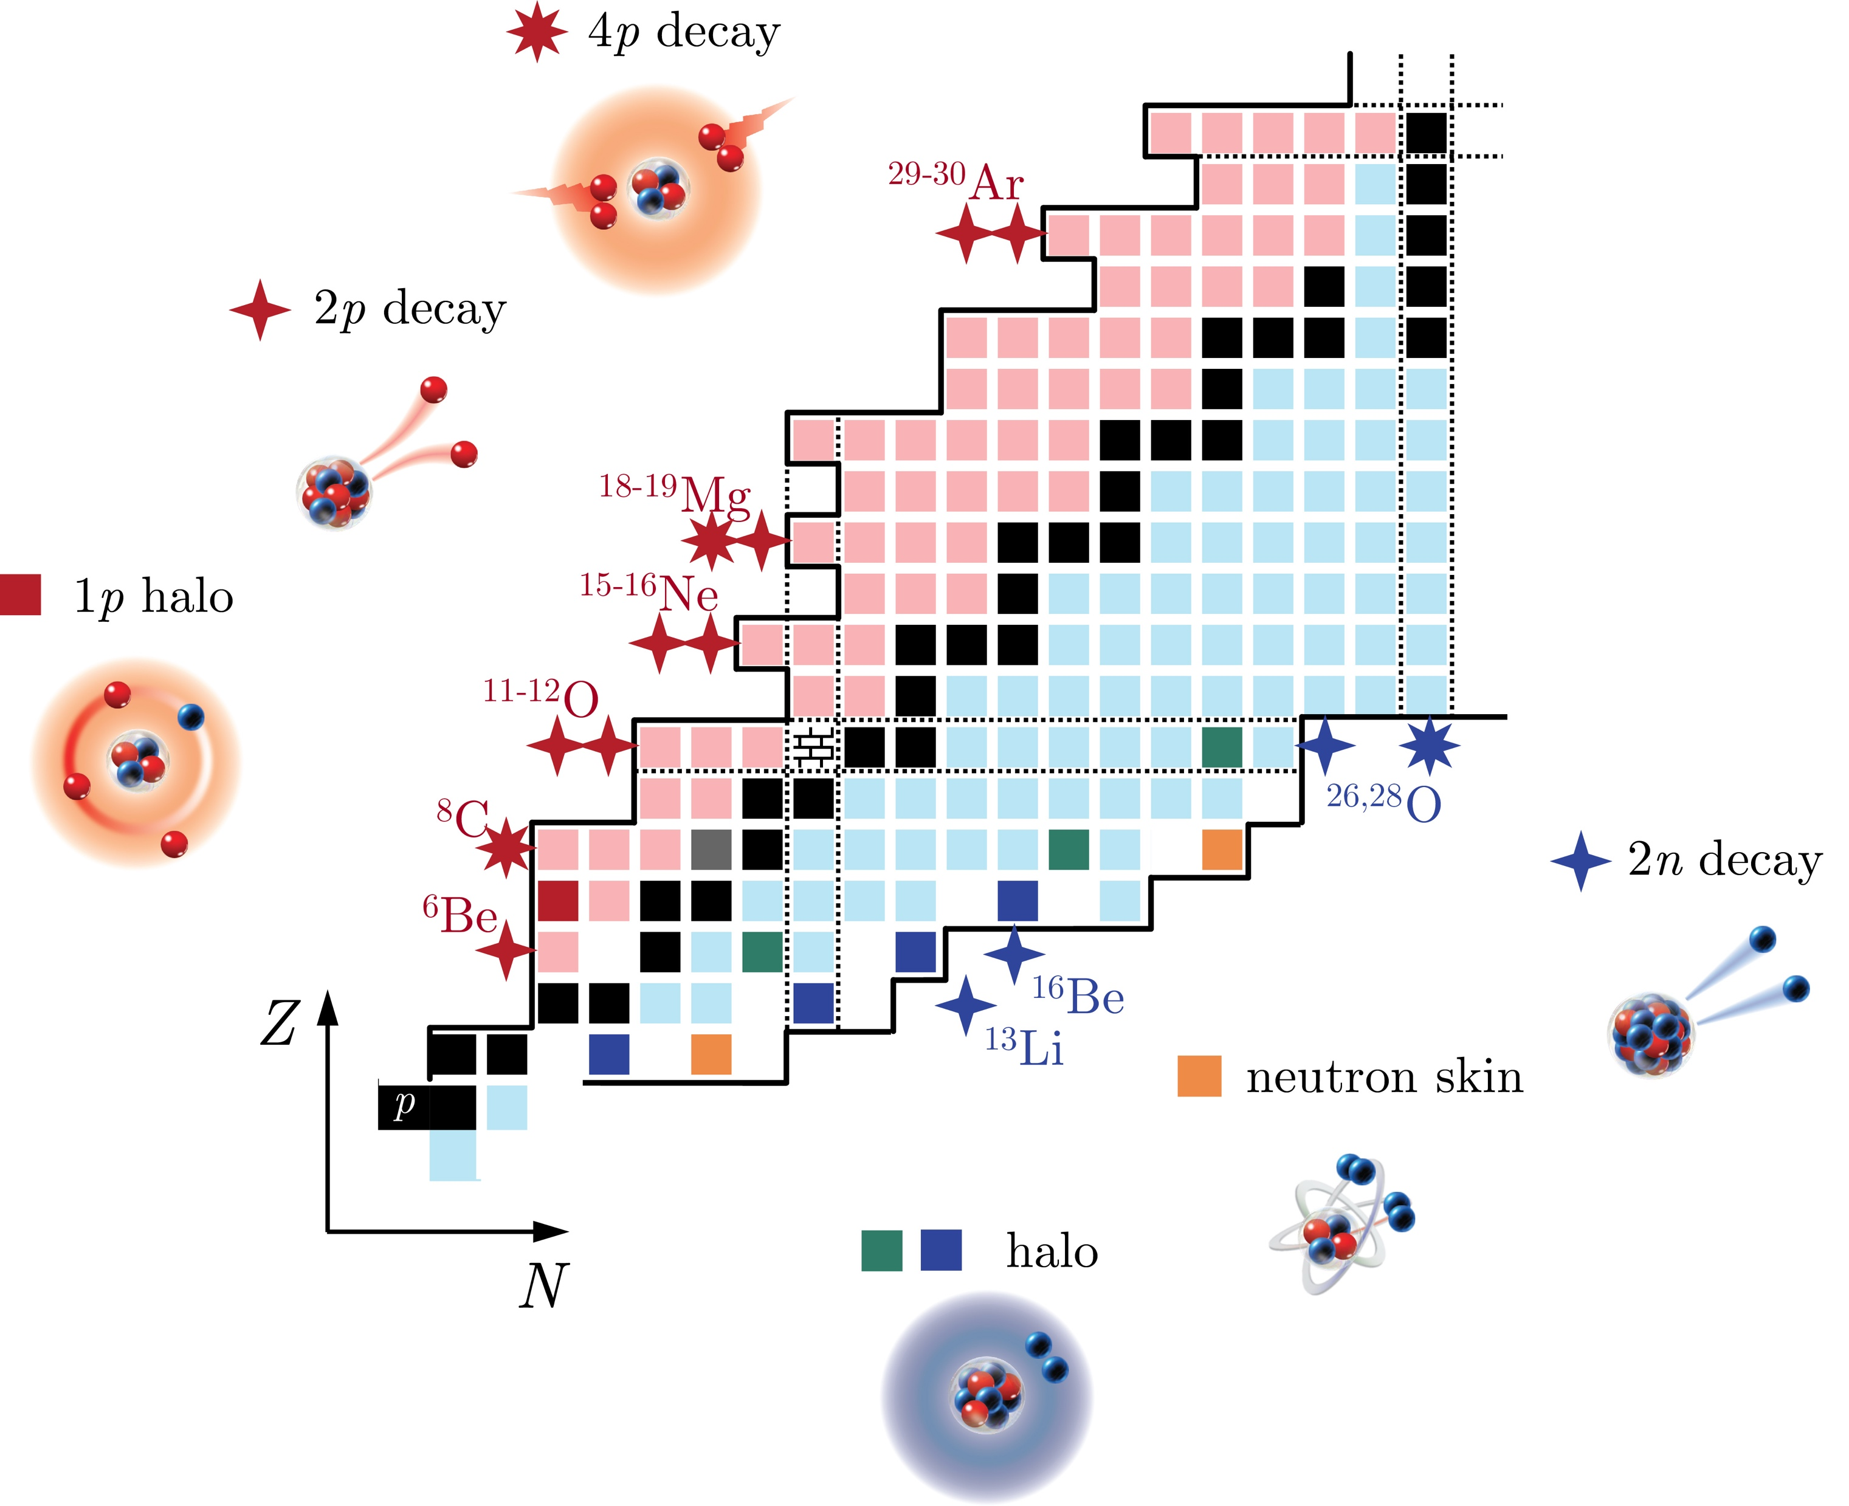
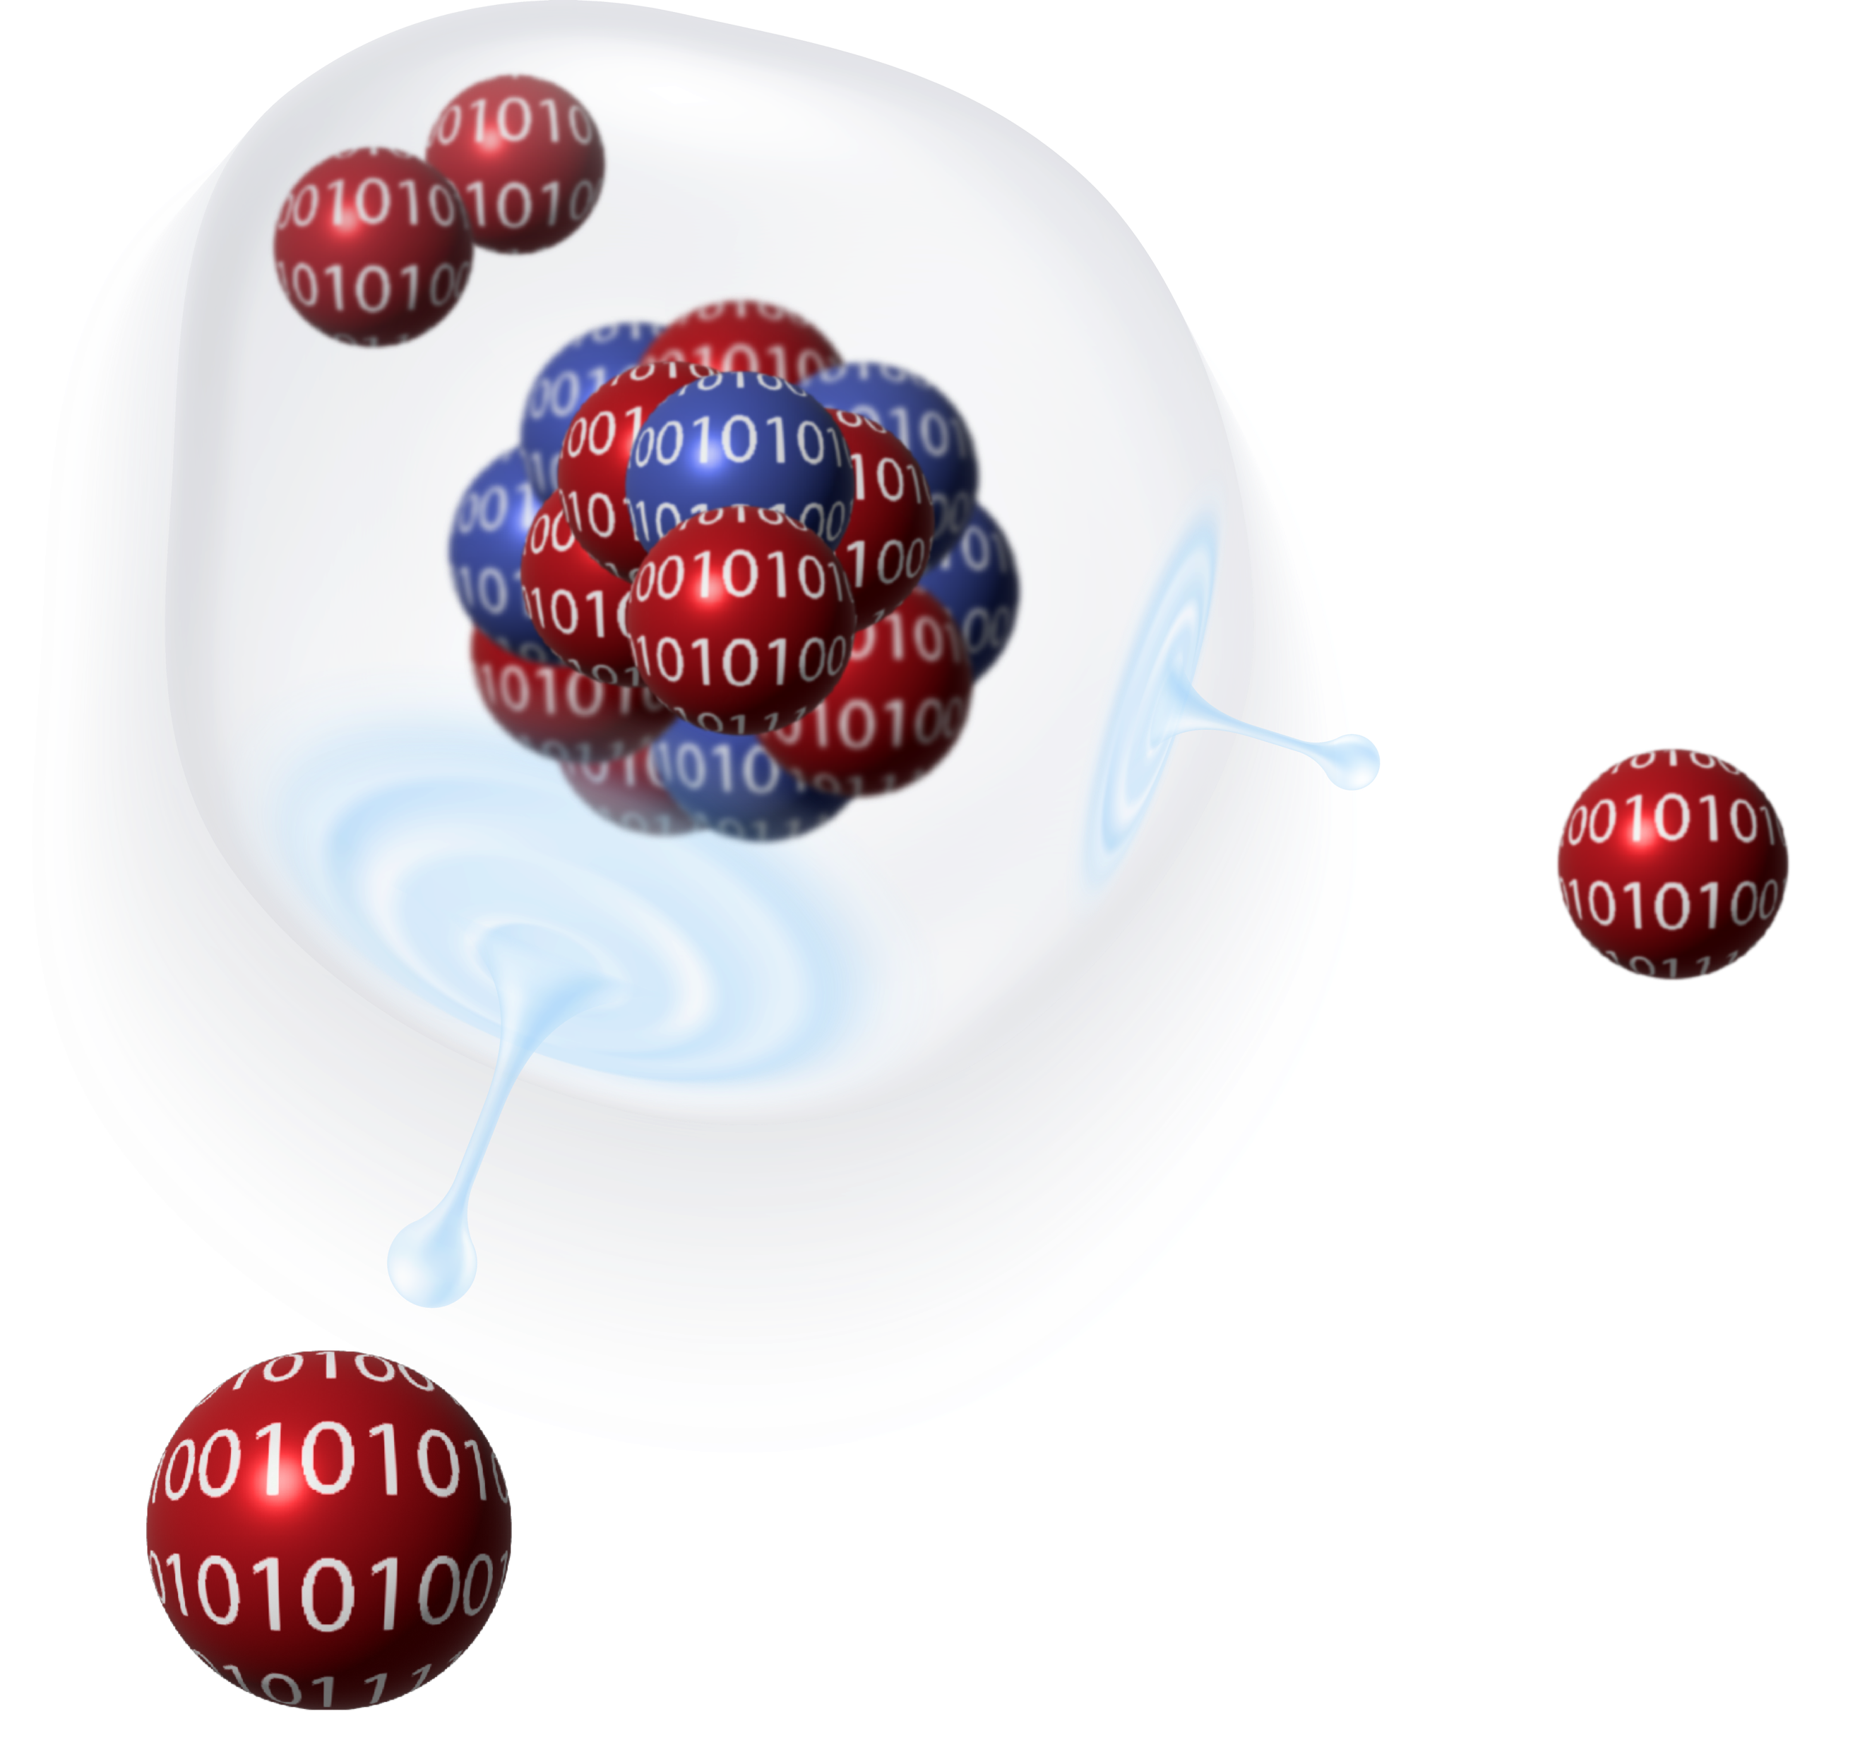
Outline
Introduction
Open quantum systems (OQSs)
Theoretical developments and challenges
Emulators for OQSs (resonances)
Response function
Resonance energy/width
Continuum coupling & asymptotic observable

Slide 3
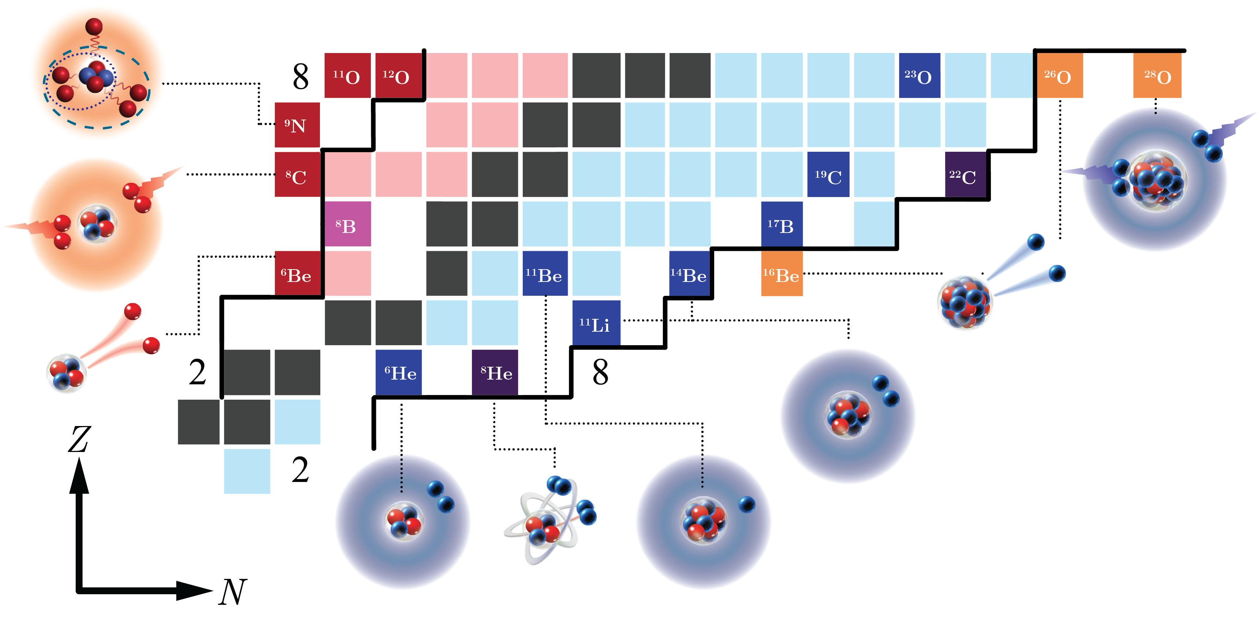
Rich phenomena towards the dripline
Closed quantum system
Open quantum system
Discovered
nuclides
Unknown
Dripline
Many-body systems
Complex physics
Non-local effect
Numerical expenses
…
Introduction
Emulators
Open quantum systems
Developments and challenges

Slide 4
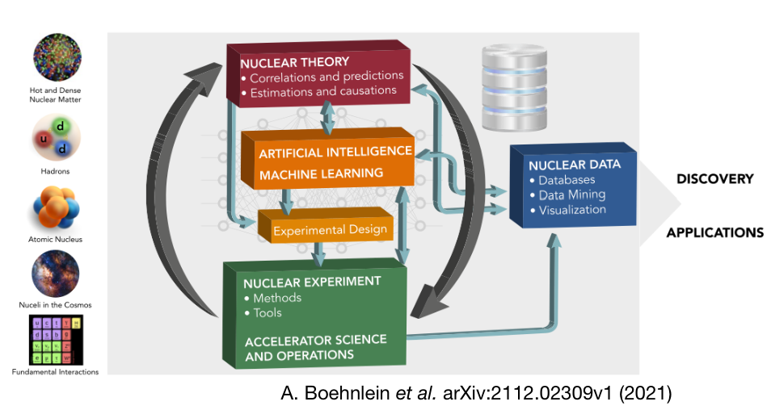
Demand of machine learning
A. Boehnlein et al., Rev. Mod. Phys. 94, 031003 (2022)
Introduction
Emulators
Open quantum systems
Developments and challenges

Slide 5
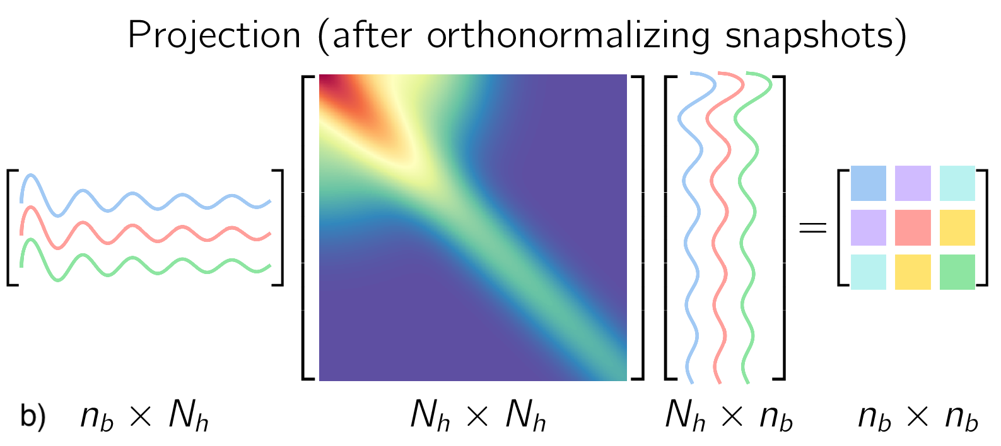
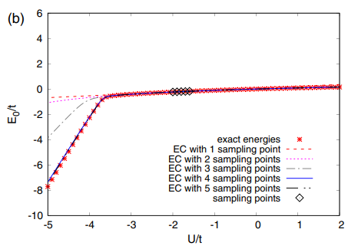
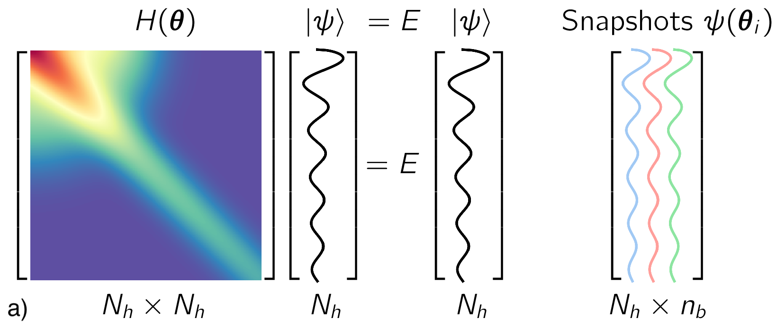
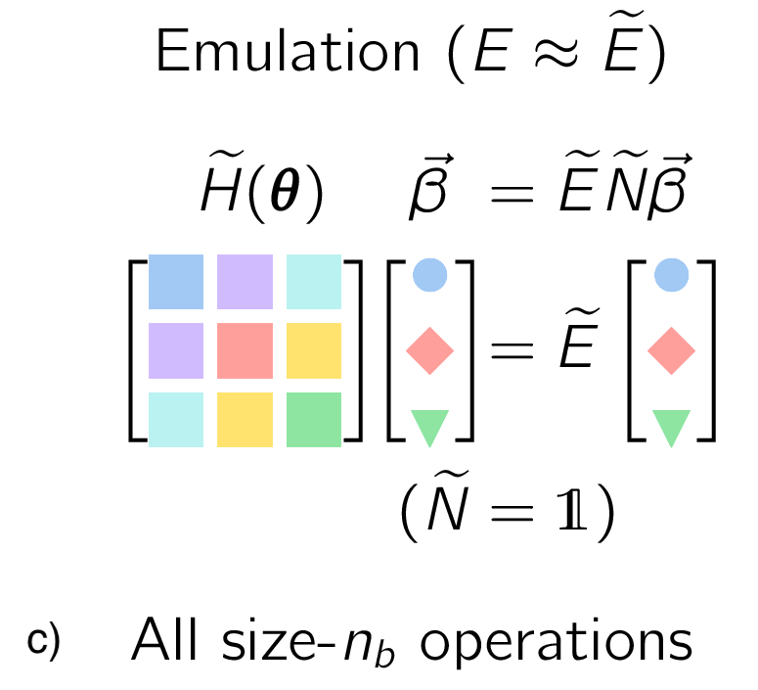
Emulator for bound system
Eigenvector continuation (EC)
Flowchart
D. Frame et al., Phys. Rev. Lett. 121, 032501 (2018)
T. Duguet et al., Rev. Mod. Phys. 96, 031002 (2024)
Eigenvalues can be extrapolated very well
Information learned by the eigenvector changes
Requirement: the continuity of the eigenvector
Introduction
Emulators
Open quantum systems
Developments and challenges

Slide 6
Emulator for bound many-body system
Reduce basis method (model driven)
Parametric matrix models (hybrid)
P. Cook et al., Nat. Commun. 16, 5929 (2025)
E. Bonilla et al., Phys. Rev. C 106, 054322 (2022)
R. Curry et al., arXiv:2510.15860 (2025)
Introduction
Emulators
Open quantum systems
Developments and challenges

Slide 7
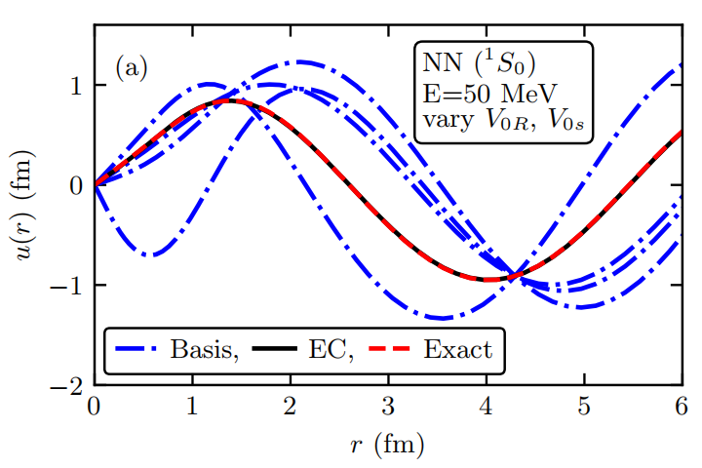
Emulator for reaction
EC for for scattering
Greedy emulators for 2b scattering
Phase shift
Wave
function
Successfully preproduce wave function, phase shift
Different from resonance prediction, E is pre-known
R. Furnstahl et al., Phys. Lett. B 809, 135719 (2020)
J. M. Maldonado et al., Phys. Rev. C 112, 024002 (2025)
Introduction
Emulators
Open quantum systems
Developments and challenges

Slide 8
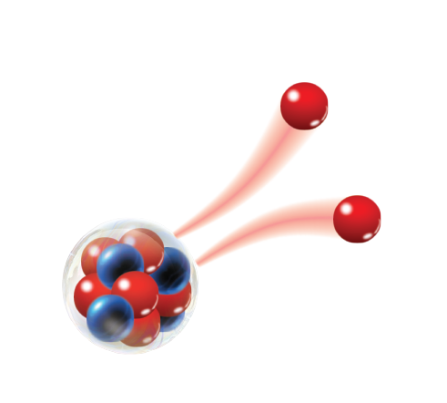

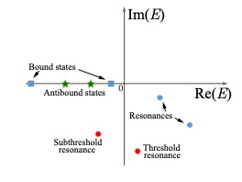
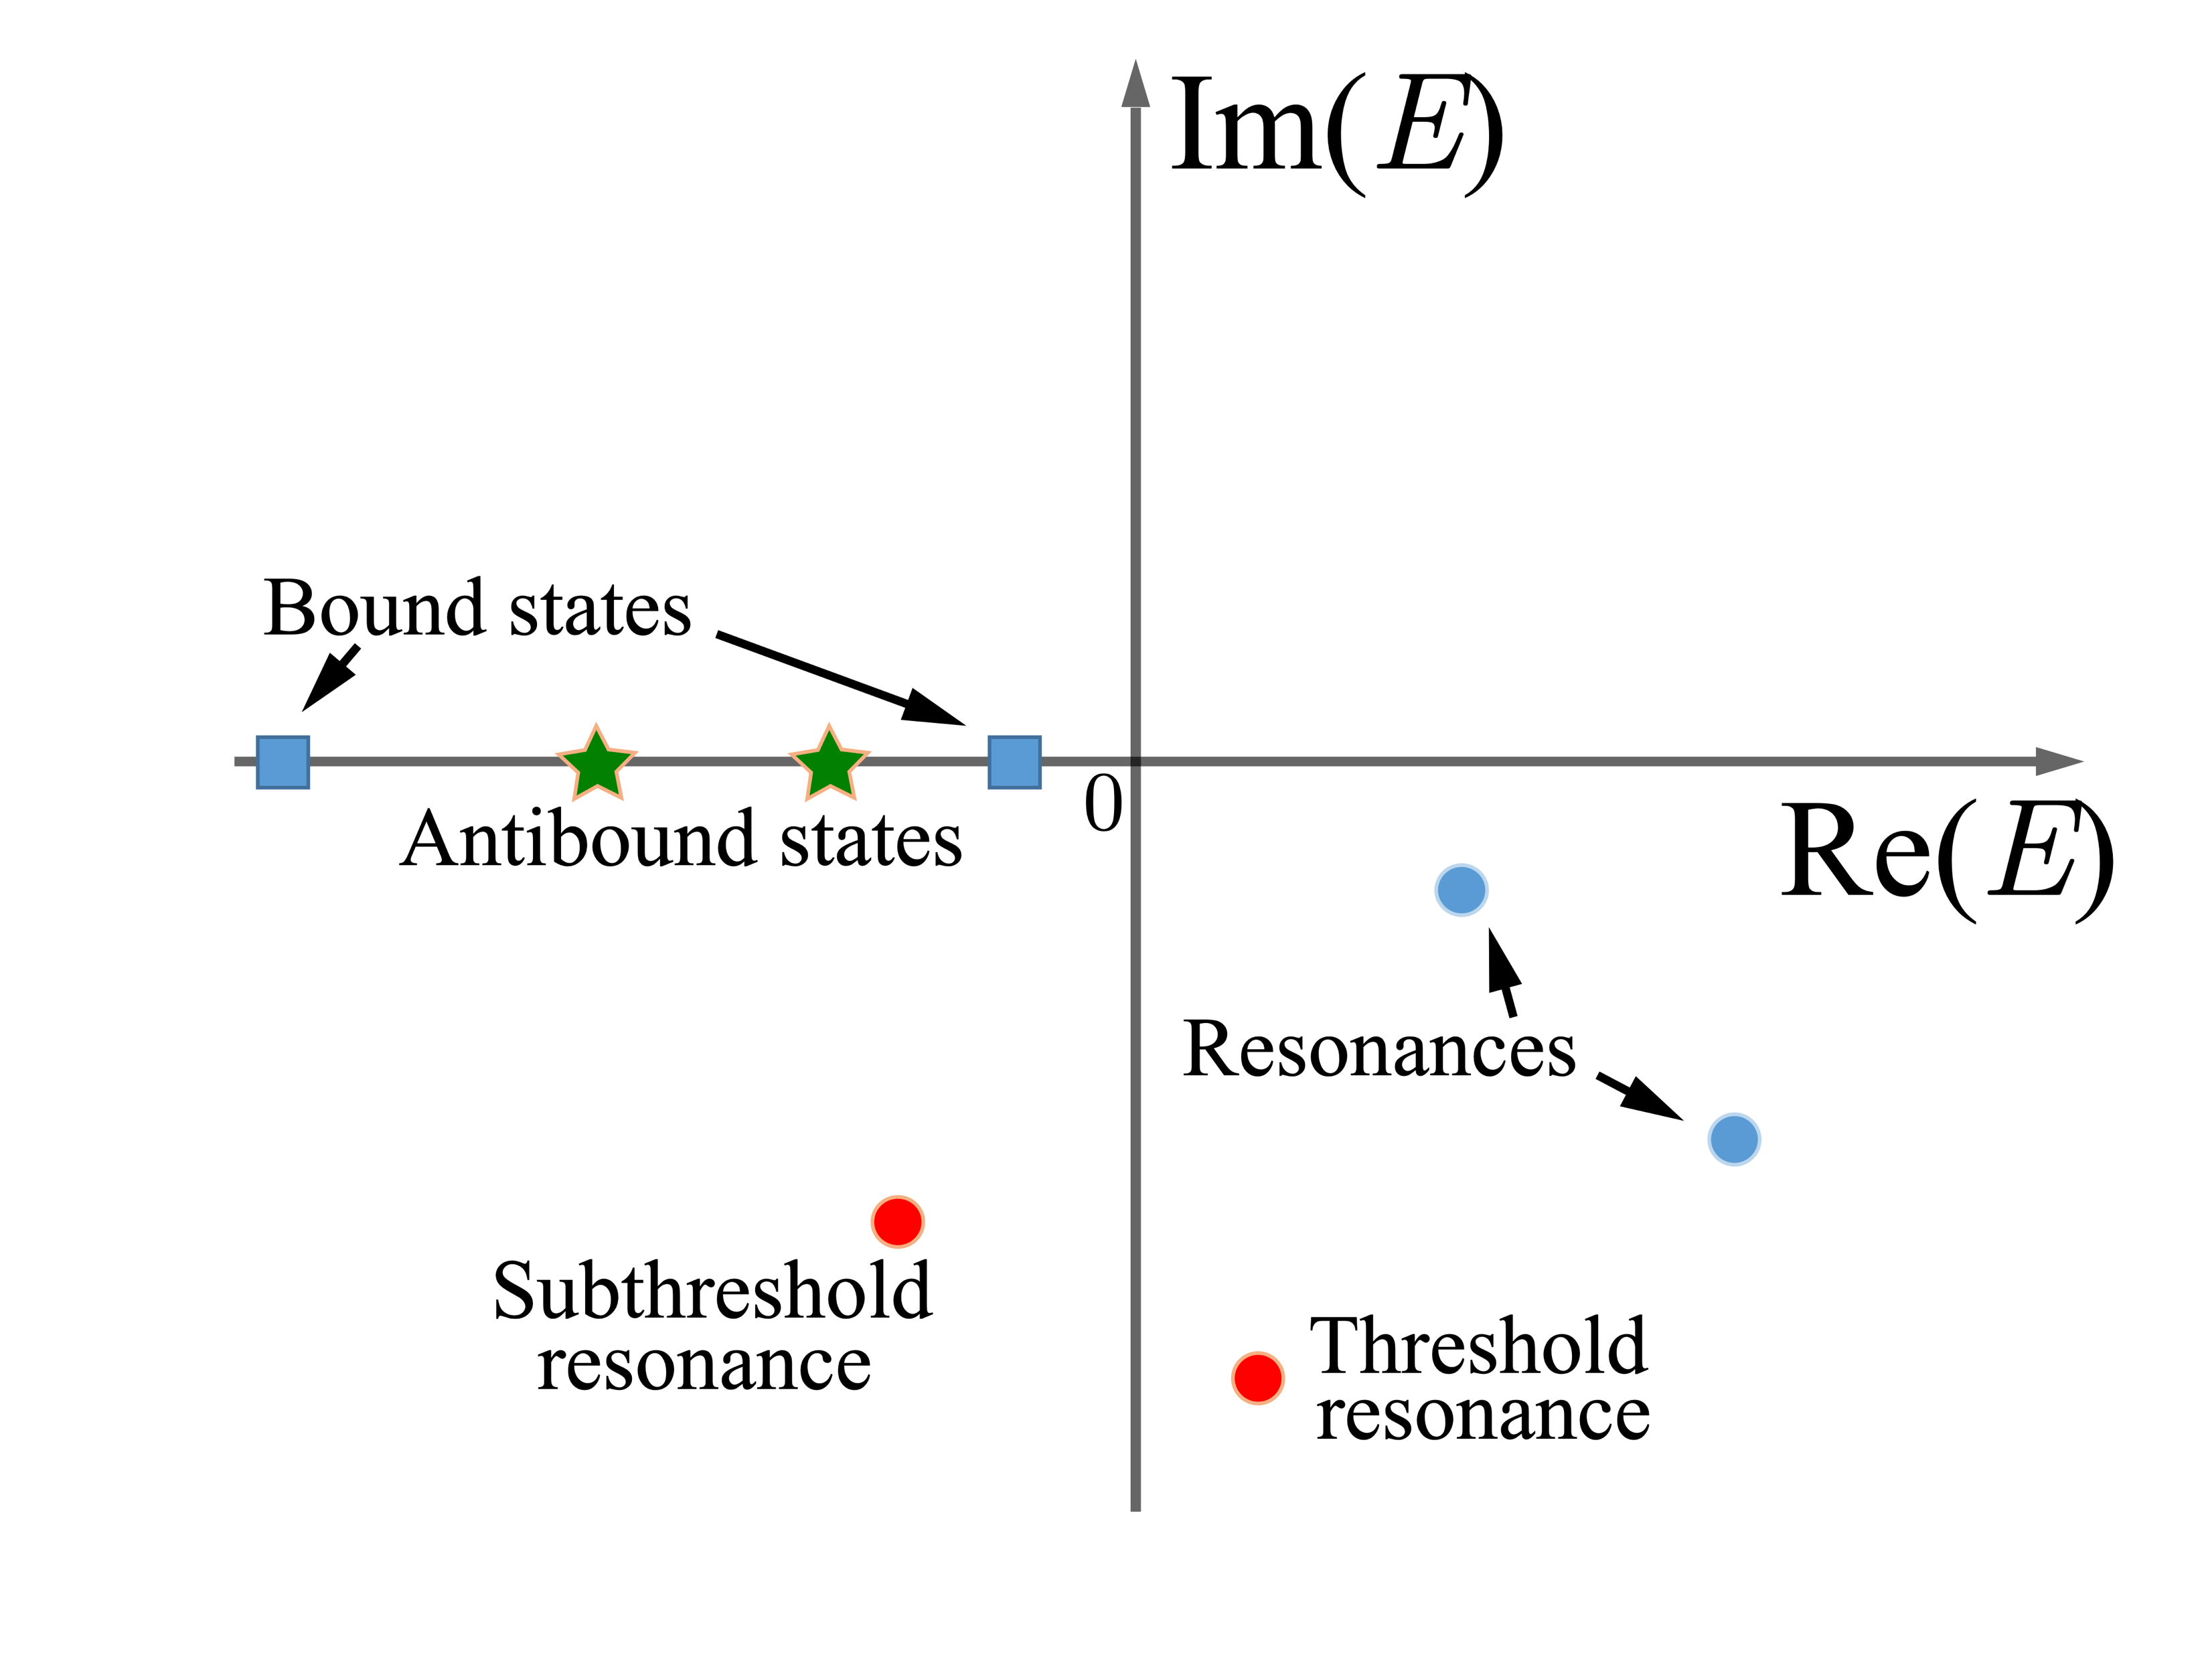
Challenges in resonance predictions
$${ Ψ}_{l}(k,r)\overset{→}{r→∞}{C^{+}}\left(k\right)H^{+}(k,r)$$
Gamow state
Complex Schrödinger equation
, where
Complex energy plane
Challenges
Complex physics
Easily impacted by the environment and asymptote
Large computational expenses
Introduction
Emulators
Open quantum systems
Developments and challenges

Slide 9
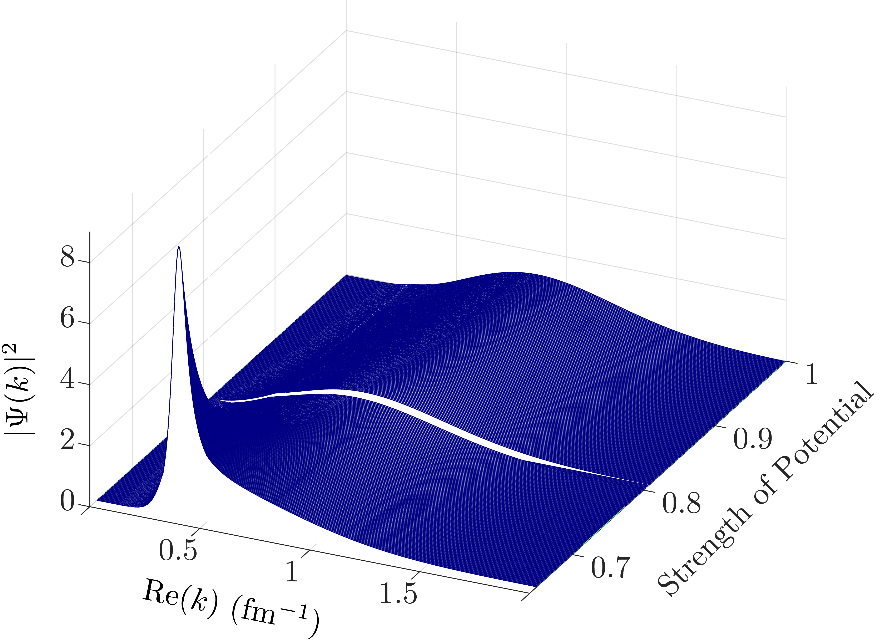
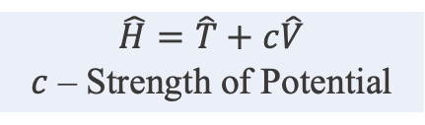
Challenges in resonance predictions
Single-particle wave function
Wigner cusp
$$\hat{H}=\hat{T}+c\hat{V}$$
$c$ – Strength of Potential
Enhancement factors
Resonant Bound
Threshold
F. C. Barker, Proc. Phys. Soc. 84, 681 (1964)
Challenges to overcome for emulators
Predict the energy and width at the same time
Short-range structure vs long-range observables
Discontinuity in wave functions and observables
Introduction
Emulators
Open quantum systems
Developments and challenges

Slide 10
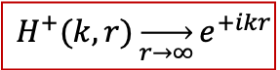
Complex-augmented eigenvector continuation
EC
Complex rotation
Conjugated
basis
CA-EC
3 training basis
$$H^{+}(k,r)\overset{→}{r→∞}{e^{+ikr}}$$
Rotate the complex plane
where
CA-EC
10 training basis
N. Yapa et al., Phys. Rev. C 107, 064316 (2023)
N. Yapa et al., Phys. Rev. C 111, 064318 (2025)
Introduction
Emulators
Open quantum systems
Developments and challenges

Slide 11
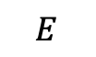
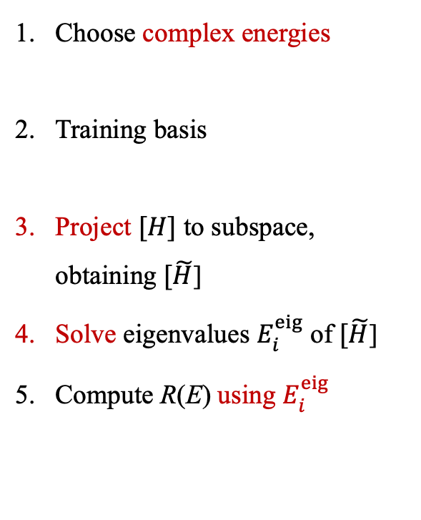
Emulator for response function
Response function
Accumulated effect from all eigen states
(bound states, resonances, and continuum)
Choose complex energies
Training basis
Project $[H]$ to subspace, obtaining $[\tilde{H}$]
Solve eigenvalues $E_{i}^{eig}$ of $[\tilde{H}$]
Compute R(E) using $E_{i}^{eig}$
Flowchart
pole
training point
$$E$$
Collaboration with X. L. Zhang
Introduction
Emulators
Response function
Resonance energy/width
Asymptotic observable

Slide 12
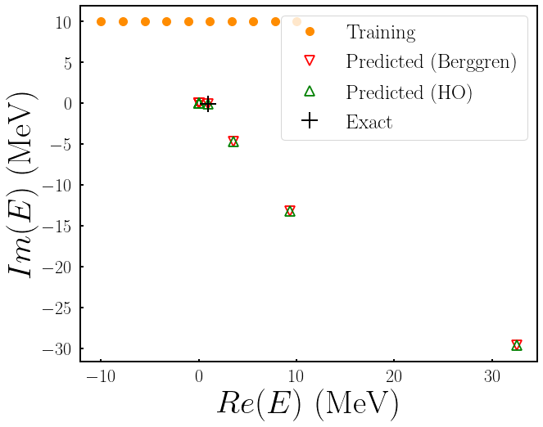
Emulator for response function
Eigen values
Response function
Basis independent
relative error ~ 3.99%
R. Y. Cheng et al., in preparation
Why does it work?
Filter
Localized wave function
Upper panel of complex plane
Introduction
Emulators
Response function
Resonance energy/width
Asymptotic observable

Slide 13
Reduce basis method (RBM)
Training basis
Eigenvectors at the n-th parameter
Solve in the high-fidelity space
Target wavefunction
Int
Int
Int
Hint:
system should vary smoothly with parameters
Collaboration with K. Godbey
Introduction
Emulators
Response function
Resonance energy/width
Asymptotic observable

Slide 14






RBM for resonances
Subspace projection
high-fidelity space
$$c_{1}$$
$$c_{2}$$
$$\hat{H}=\hat{T}+c\hat{V}$$
$c$ – Strength of Potential
$$c_{⨀}$$
training points
Project space Y_{proj}
Threshold
projecting
subspace
$$c_{⨀}$$
$$c_{2}$$
$$c_{1}$$
Training basis 𝑿_{𝐭𝐫𝐚𝐢𝐧}: at different parameters such as potential strength 𝒄 or the complex energy 𝑬
Projecting basis 𝒀_{𝐩𝐫𝐨𝐣}: smoothly changed subspace, such as high-momentum free-particle wave
Internal region of a nucleus
Introduction
Emulators
Response function
Resonance energy/width
Asymptotic observable

Slide 15




RBM for resonances
Two-body system
Three-body system
Training basis 𝑿_{𝐭𝐫𝐚𝐢𝐧}: at different parameters such as potential strength 𝒄 or the complex energy 𝑬
Projecting basis 𝒀_{𝐩𝐫𝐨𝐣}: smoothly changed subspace, such as high-momentum free-particle wave
Internal region of a nucleus
Introduction
Emulators
Response function
Resonance energy/width
Asymptotic observable

Slide 16
Principal-component analysis
Crucial region for continuum
Wave
function
SVD
𝒀_{𝐩𝐫𝐨𝐣}
Principal components
R. Y. Cheng et al., Phys. Rev. C 111, 064315 (2025)
Training wave function can be bound states
Introduction
Emulators
Response function
Resonance energy/width
Asymptotic observable

Slide 17
Accuracy & efficiency
k ∈ [0.5, 1.0] corresponds to the inner-nucleus region strongly impacted by the structure
Introduction
Emulators
Response function
Resonance energy/width
Asymptotic observable

Slide 18
But at what cost?
Wavefunction matches inside the nucleus (mid- & high-momenta), but fails asymptotically for both emulators
Asymptotic-observable predictions might be challenging
Introduction
Emulators
Response function
Resonance energy/width
Asymptotic observable

Slide 19
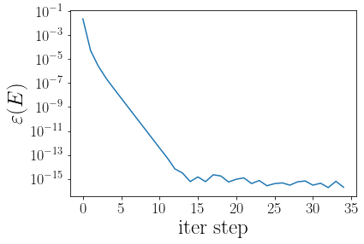
Wavefunction correction
Problem: the emulated wavefunction has ignored the asymptotic behavior
localized
Lippmann-Schwinger equation
Consider the numerical stability:
Energy error
Iterate to improve
Cost is trivial
Maintain the localized component as a reference
Introduction
Emulators
Response function
Resonance energy/width
Asymptotic observable

Slide 20
Wavefunction correction
L-S correction improves the overall wave function
Require additional steps
Introduction
Emulators
Response function
Resonance energy/width
Asymptotic observable

Slide 21
Emulator for asymptotic observables
Challenges: handle structure and asymptotic observables on the same footings
Potential solutions:
RBM for resonances/response function
Good for structure & energy
Require additional process for asymptotic wave function
PMM for open quantum systems (ongoing project)
Maintains quantum mechanical interpretability
Train energy and observable simultaneously
Underlying equations
PMM
Adopted from D. Jammooa’s presentation
Introduction
Emulators
Response function
Resonance energy/width
Asymptotic observable

Slide 22
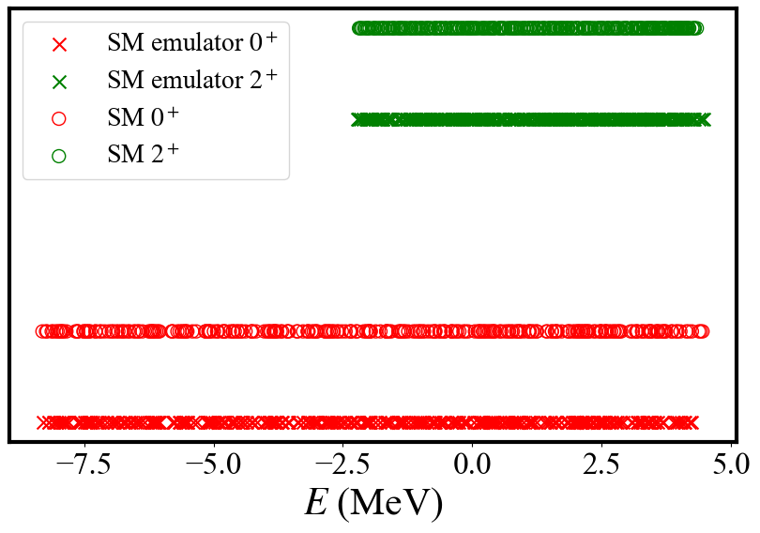
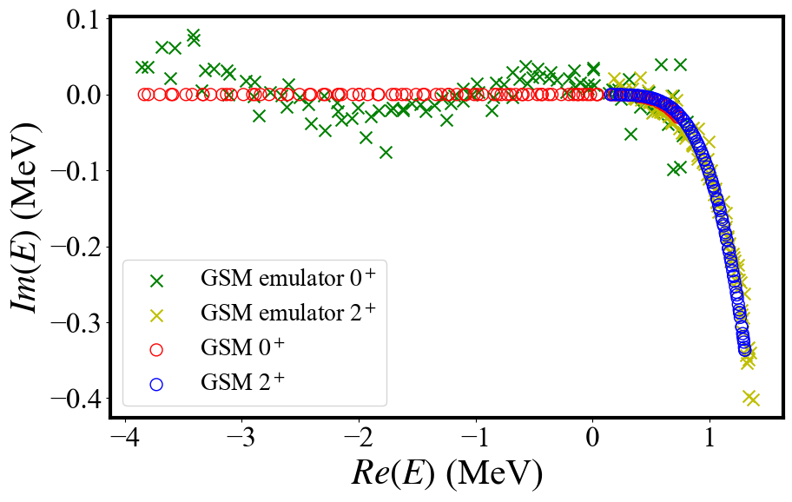
PMM first attempt
PMM for closed systems
PMM for open systems
Symmetric complex Hamiltonian
PMM works very well for closed quantum systems (CQSs)
Extend to rigged Hilbert space for open quantum systems (OQSs)
Fails to reproduce the eigen values directly
Introduction
Emulators
Response function
Resonance energy/width
Asymptotic observable

Slide 23
Emulator for asymptotic observables
Open quantum system
P
Q
Prepare training data (E, O)
for close and open systems
Train CQSs
Closed quantum physics
Continuum physics
Continuum coupling
Train OQSs similarly
Find E through
Introduction
Emulators
Response function
Resonance energy/width
Asymptotic observable

Slide 24
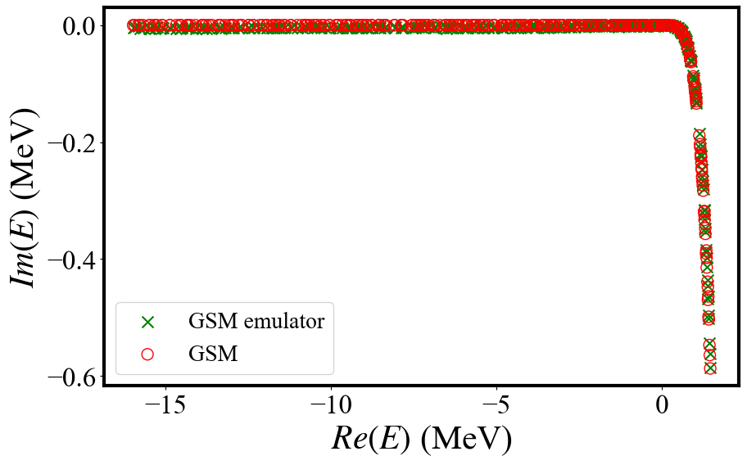
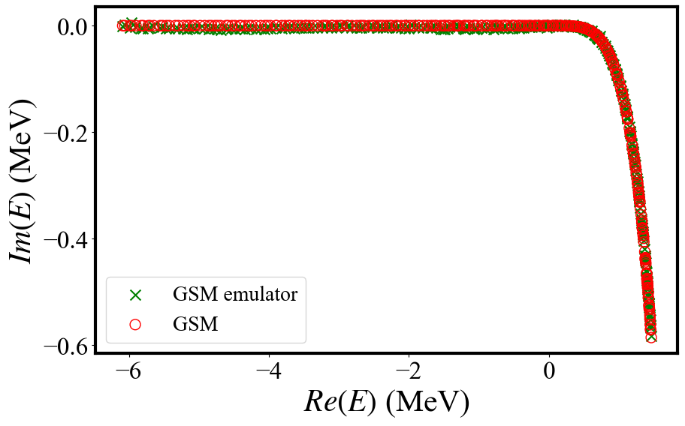
Emulator for asymptotic observables
⁶He Ground state
⁶He 2⁺ state
Preliminary
Based on PQ method, construct GSM emulator
Use SM emulator to obtain eigenstates, guide the selection of corresponding states
GSM emulator reproduce the high-fidelity results very well
Introduction
Emulators
Response function
Resonance energy/width
Asymptotic observable

Slide 25
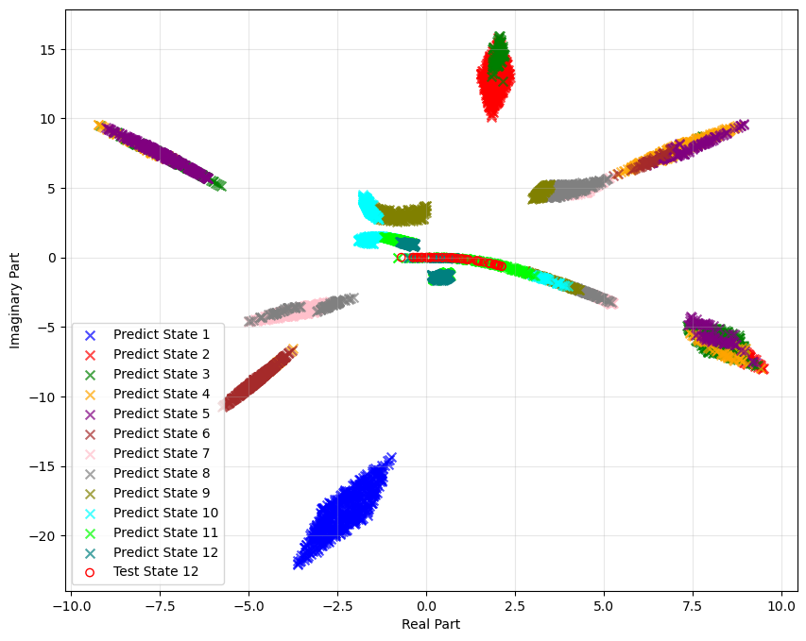
Emulator for asymptotic observables
⁶He Ground state
Eigenvalue distribution
Preliminary
Based on PQ method, construct GSM emulator
Use SM emulator to obtain eigenstates, guide the selection of corresponding states
GSM emulator reproduce the high-fidelity results very well
Introduction
Emulators
Response function
Resonance energy/width
Asymptotic observable

Slide 26
Perspectives
⁶He Ground state
⁶He 2⁺ state
Preliminary
Try to study the continuum coupling
𝑉_{𝑇}¹¹ ​shows weakest constraint​ with widest posterior distribution
Parameter correlations​ reveal compensation effects in nuclear force components
Introduction
Emulators
Response function
Resonance energy/width
Asymptotic observable

Slide 27










Thank you for your attention!
Summary
Open quantum systems: complex physics, asymptotic behavior, decaying property
Emulators
EC for response function
RBM for resonance energy/width
PMM for continuum coupling
Perspectives
Uncertainty quantifications
Time evolution
Other observables: nn correlations
R. Y. Cheng
K. Godbey
W. Nazarewicz
A. Volya
Z. C. Xu
X. L. Zhang
Y. G. Ma
…
Acknowledgements
Collaborators
…

Slide 28
Questions
How to handle both internal and external wave function properly?
How to connect the asymptotic observables with structure information?
How to improve the prediction power of an emulator?
If there are some uncertainties/errors in the training data, can the emulator handle it?
A data driven PMM?

Slide 29
Backup

Slide 30
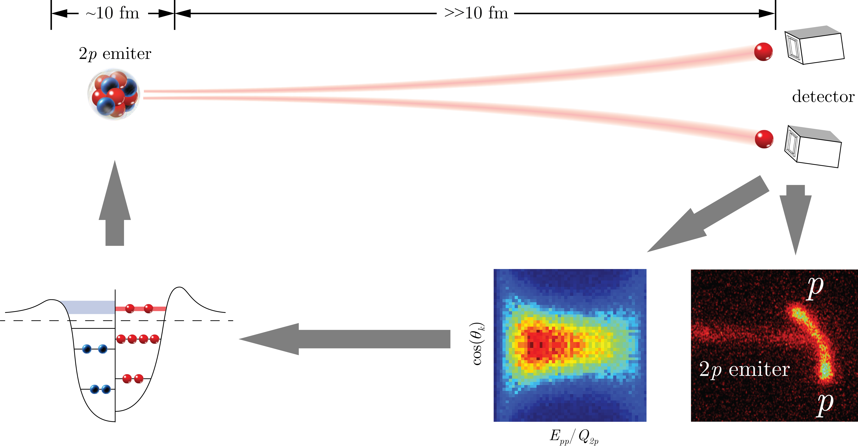
Structure Asymptotic observables
Structure
Decay & reaction
macroscopic distance
pairing correlation
structure
’
Numerical method
“characteristics”
“fingerprint”
K. Miernik et al., Phys. Rev. Lett. 99, 192501 (2007)
Introduction
Emulators
Response functions
Resonances
Asymptotic observables

Slide 31
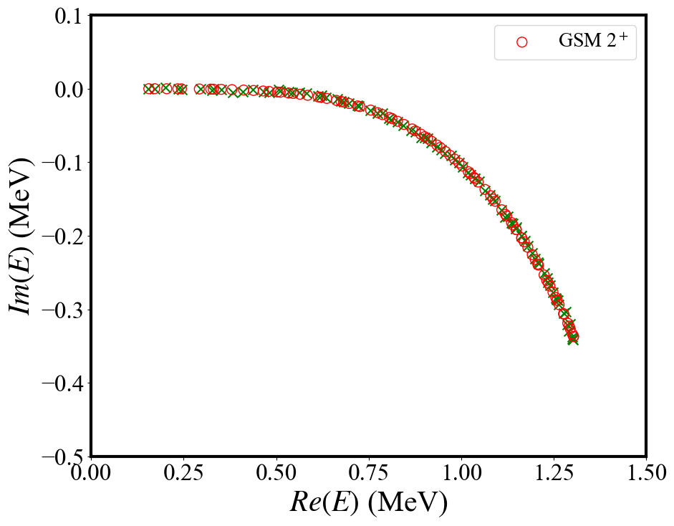
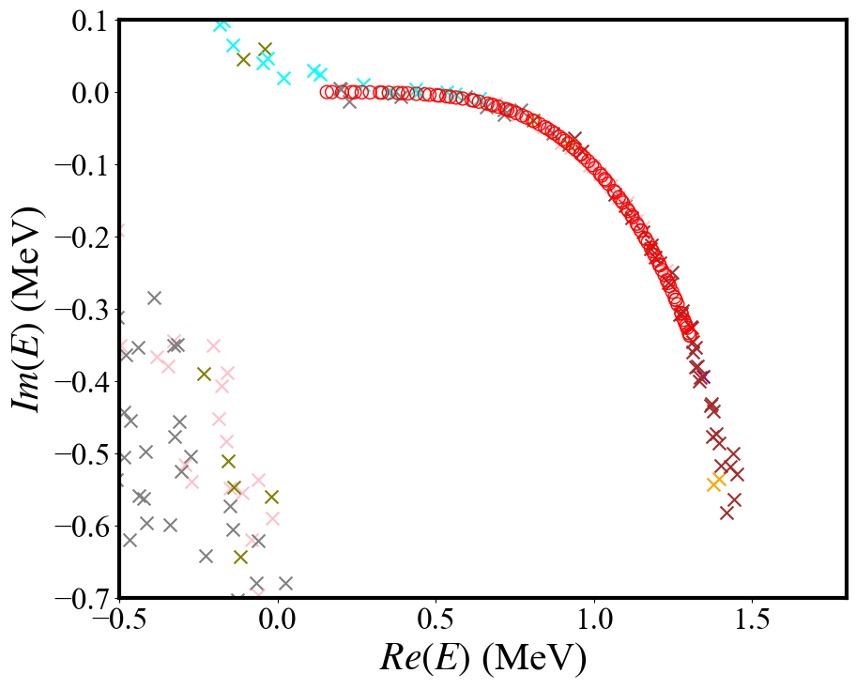
GSM emulator extrapolation
We change the way to train the emulator, in which we find the closest value to train. The results is better, but not good enough.
train data
extrapolation
The eigenvalues of the matrices are widely dispersed.
The extrapolation capability appears to be bad.
The eigenvalues on the extrapolation line do not originate from the same energy level series.

Slide 32
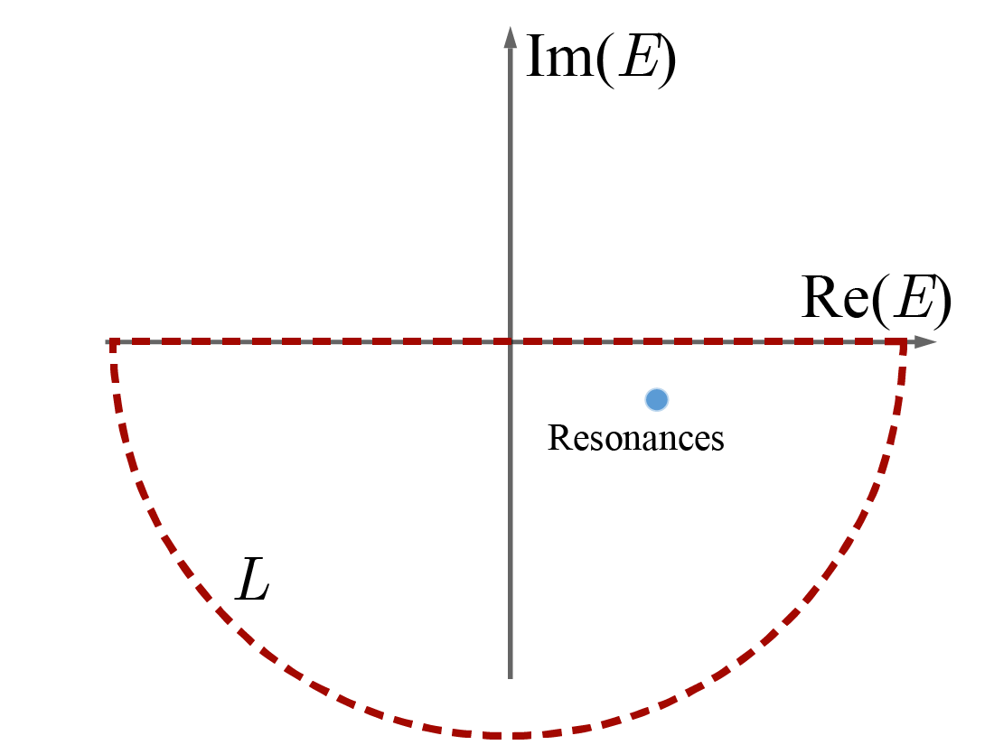
Quantum picture of decay
$${ Ψ}_{l}(k,r)\overset{→}{r→∞}{C^{+}}\left(k\right)H^{+}(k,r)$$
Gamow state
Real-energy expansion
Complex energy plane
Survival probability
Spectral function

Slide 33
Gamow coupled-channel (GCC) method
The 3-body Hamiltonian can be written as:
Total wave-function
valence nucleons deformed core
Jacobi coordinates
No spurious center-of-mass motion
Proper 3-body asymptotic behavior
Berggren basis
Bound, scattering, and Gamow states
Structure and decay information
Berggren basis
SW and W. Nazarewicz, Phys. Rev. Lett. ﻿120, 212502 (2018)

Slide 34
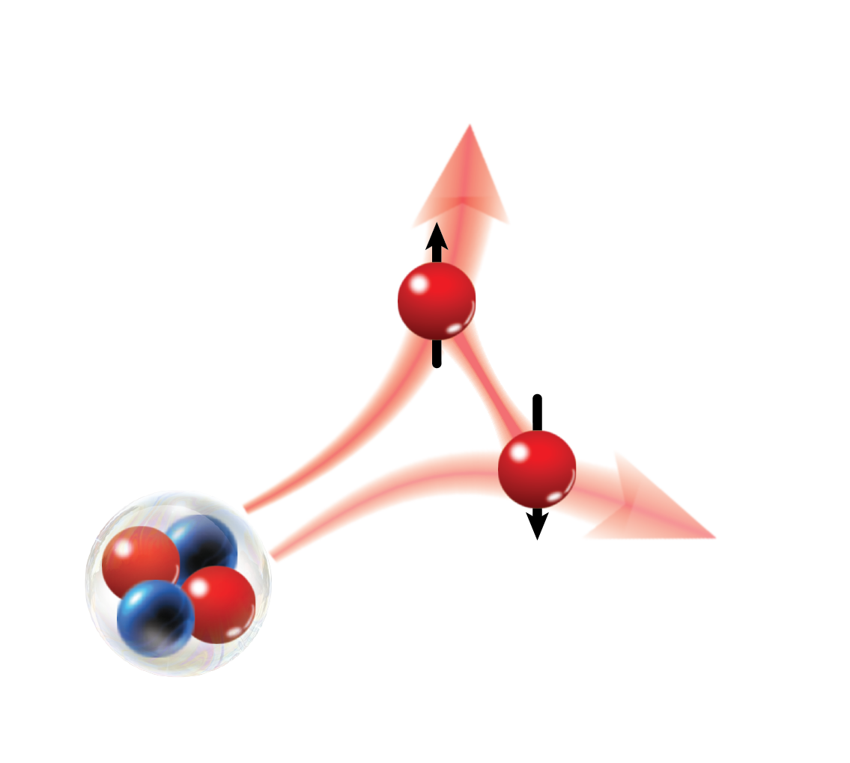
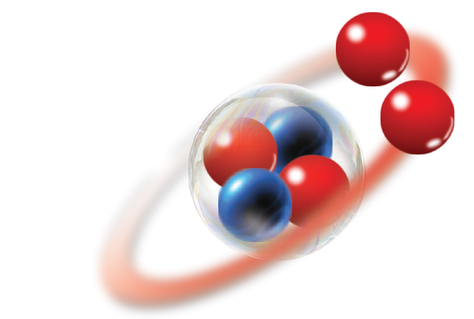
Time dependent (TD) approach
In order to study the dynamics of 2p decay
Time dependent approach
Time propagator can be expanded with Chebyshev polynomials.
Initial wave function is obtained by GCC, which includes configuration mixing and proper asymptote.
Two-proton wave function has been propagated to over 500 fm.
Green’s functional method to benchmark
Time propagator and Green’s function can be connected by Fourier transformation.
Open quantum system
Configuration mixing
Correlation
GCC
~500 fm
High precision in asymptote
Coulomb field
SW and W. Nazarewicz, Phys. Rev. Lett. 126, 142501 (2021)

Slide 35
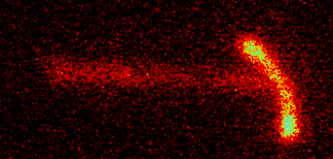
Two-proton (2p) decay
⁴⁵Fe
﻿J. Giovinazzo et al., Phys. Rev. Lett. 89, 102501 (2002)
Jacobi
Single-particle
(s, s)
(p, p)
(d, d)
(f, f)
(0, 0)
clustering
K. Miernik et al., Phys. Rev. Lett. 99, 192501 (2007)
Diproton structure will introduce configuration mixing.

Slide 36
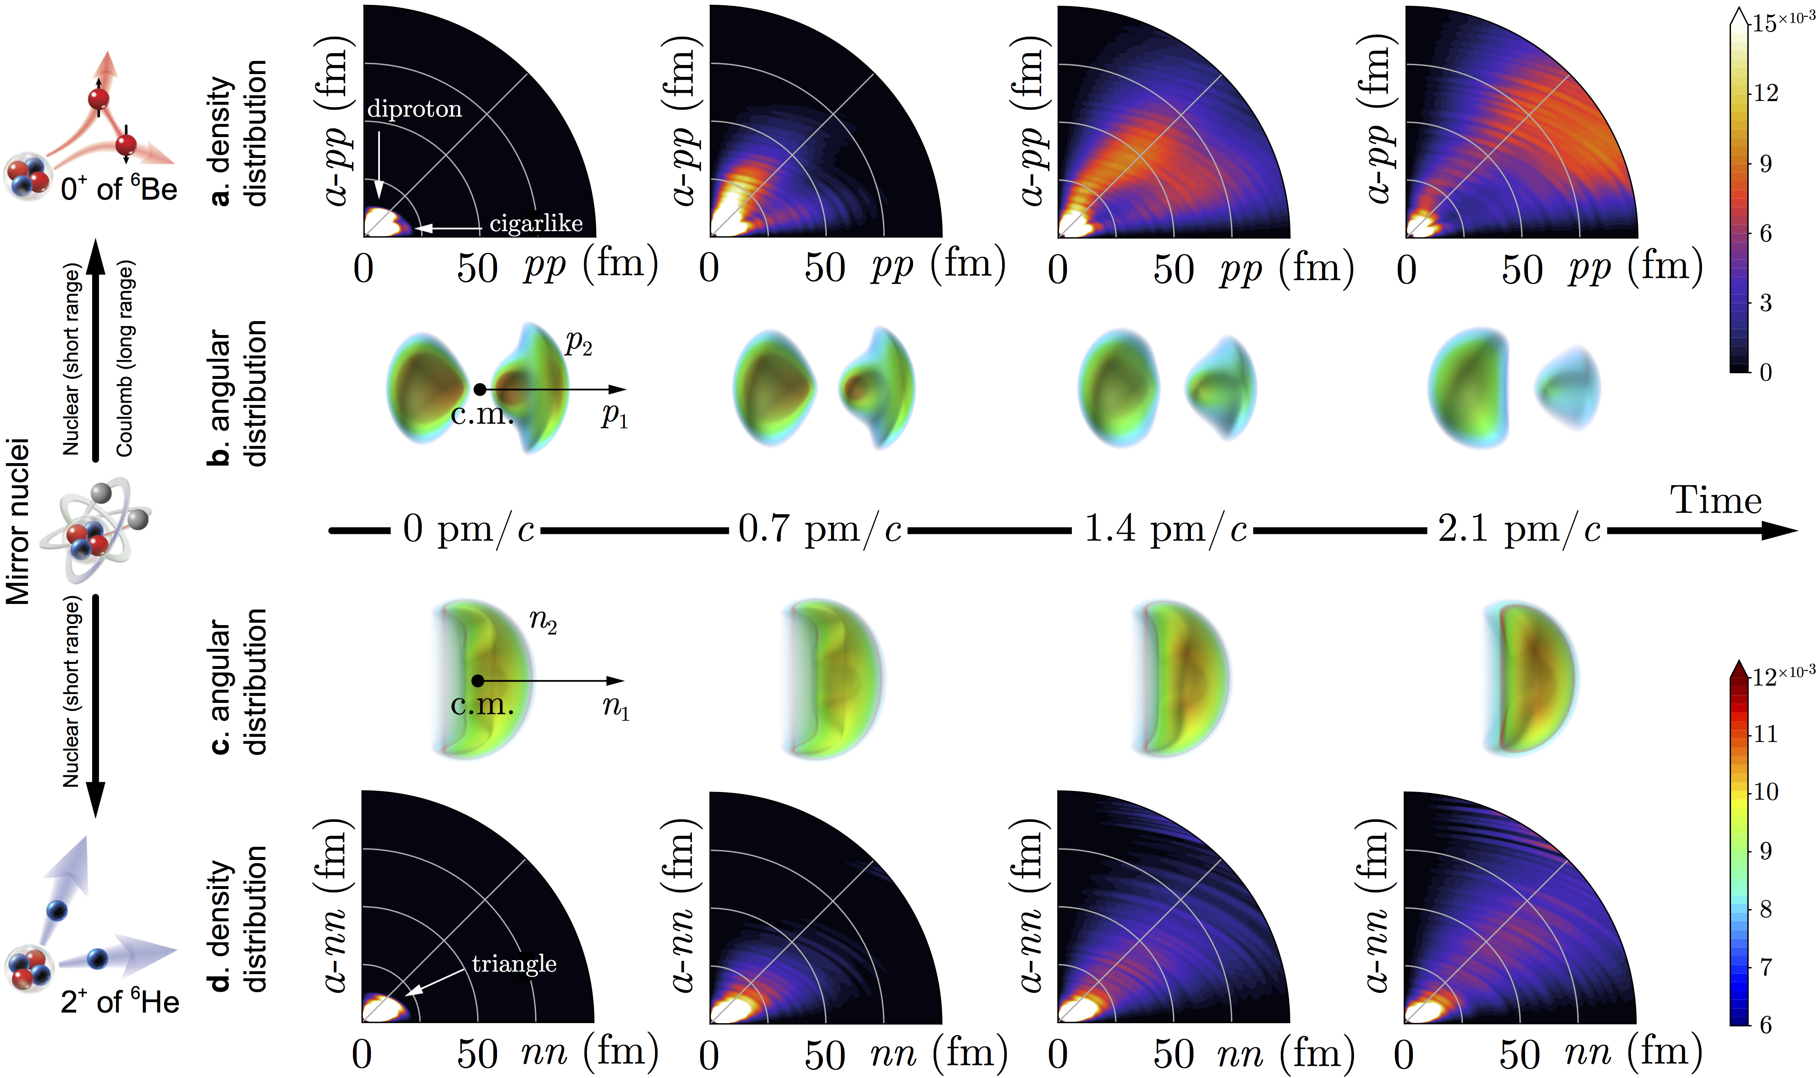
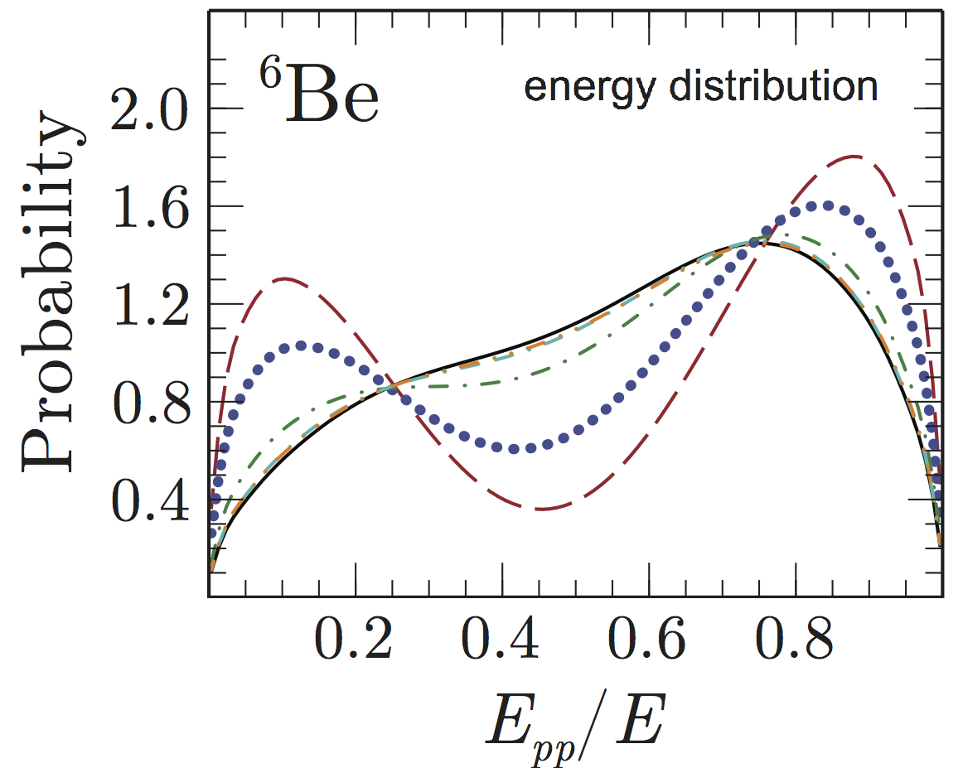
2p decay in ⁶Be
Protons inside nucleus
Two types of tunneling:
diproton (primarily)
cigarlike
Diproton branch bends
due to Coulomb repulsion
Asymptotic correlation begin to converge
SW and W. Nazarewicz, Phys. Rev. Lett. 126, 142501 (2021)

Slide 37
Complex-plane framework
Decay width/Lifetime
Complex symmetric Schrödinger equation
, where
Complex momentum plane
Complex energy plane

Slide 38
Asymptotic nucleon-nucleon correlation
K. Miernik et al. PRL 99, 192501 (2007)
⁴⁵Fe
’
p-shell
sd-shell
’
T.B. Webb et al. Phys. Rev. C ﻿100, 024306 (2019)

Slide 39
Asymptotic correlations
E_{pp} and Y-type angular correlations are strongly impacted by nucleon-nucleon interaction.

Slide 40
Observed 2p emitters

Slide 41
Correlations of light-mass nuclei

